Slide 1
Fungi
( Classification, cell structure , types fungal disease, economical importance )
Presented By
Yeamin Alam Chowdhury
BMB22001
Supervised By
Fahim Alam Nobel
Lecturer
Department of BMB

Slide 2

Fungi A plant like organism that doesn’t make chlorophyll.

Slide 3
Classification
Fungi
Spore
Nutrition
Saphrophytic
Parasite
Symbiotic
Phycomycetes
Zygomycetes
Lichen
Albugo
Ascomycetes
Deuteromycetes
Mucor
Aspergillus
Penicillium
Taphrina
Saccharomyces
Trichoderma
Basidiomycetes
Agaricas

Slide 4
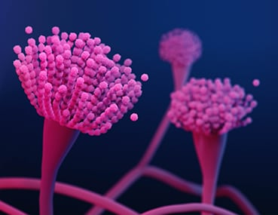
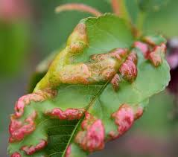
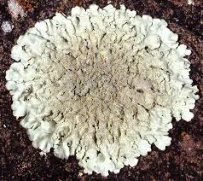
Saprophytic Aspergillus, Penicillium
Parasite: Taphrina
Symbiotic: Lichen
Aspergillus
Taphrina
Lichen

Slide 5
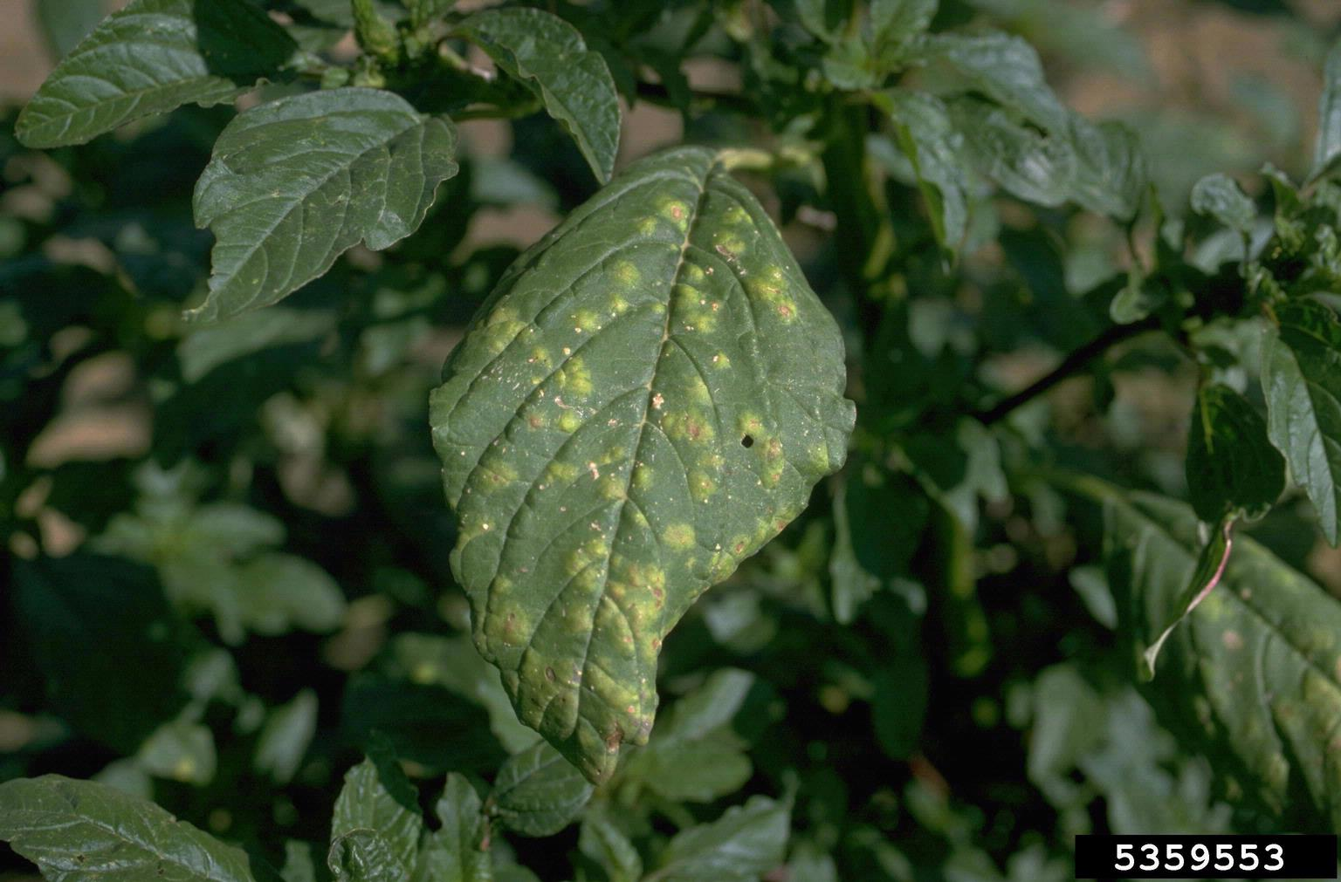
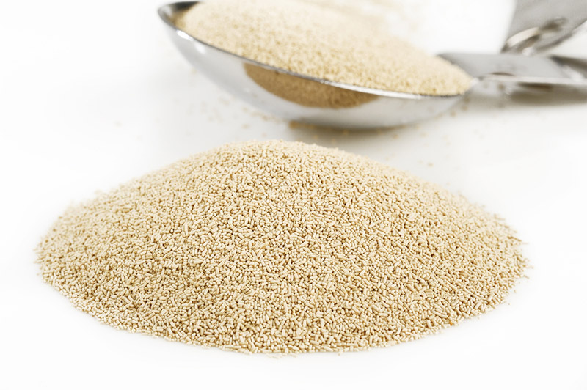
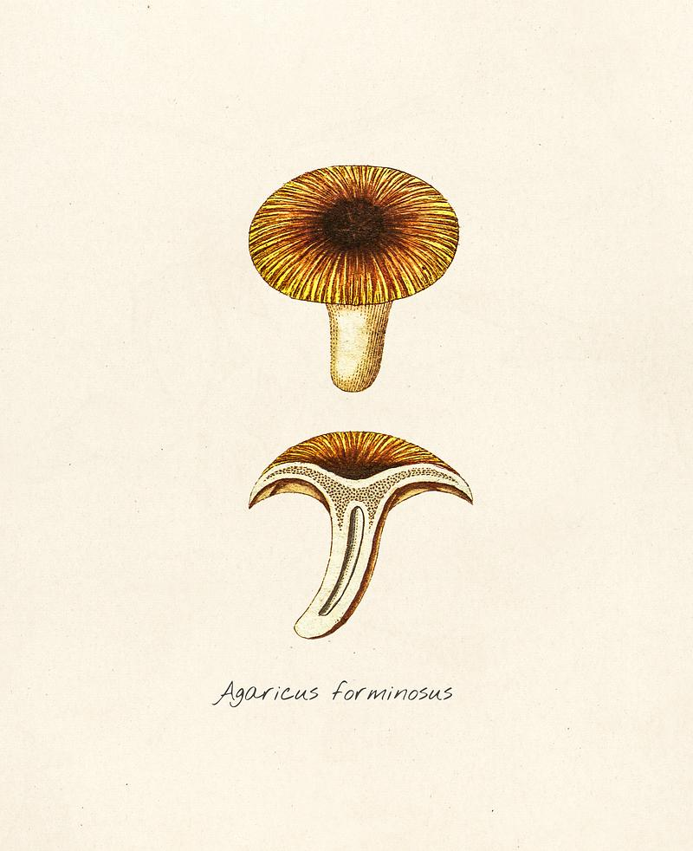
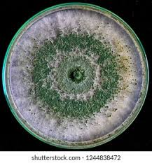
Phycomycetes: Albugo
Ascomycetes : Yeast
Basidiomycetes: Agaricas
Deuteromycetes: Trichoderma

Slide 6
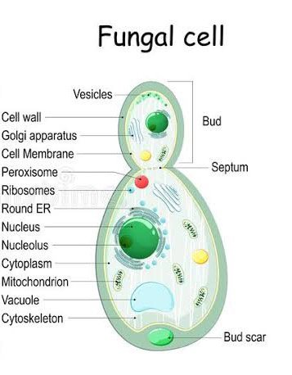
Cell Structure

Slide 7
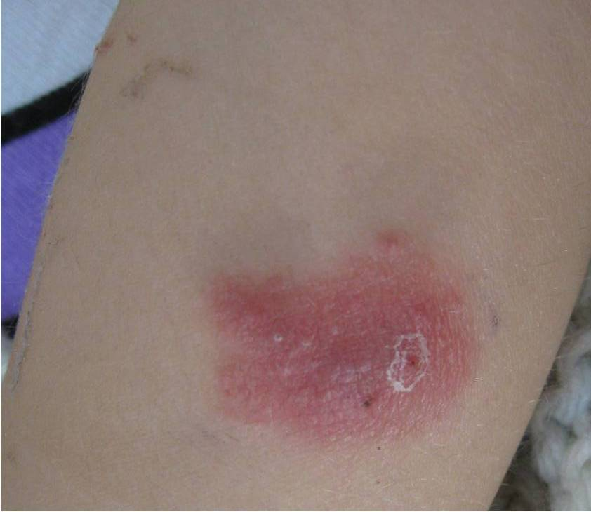
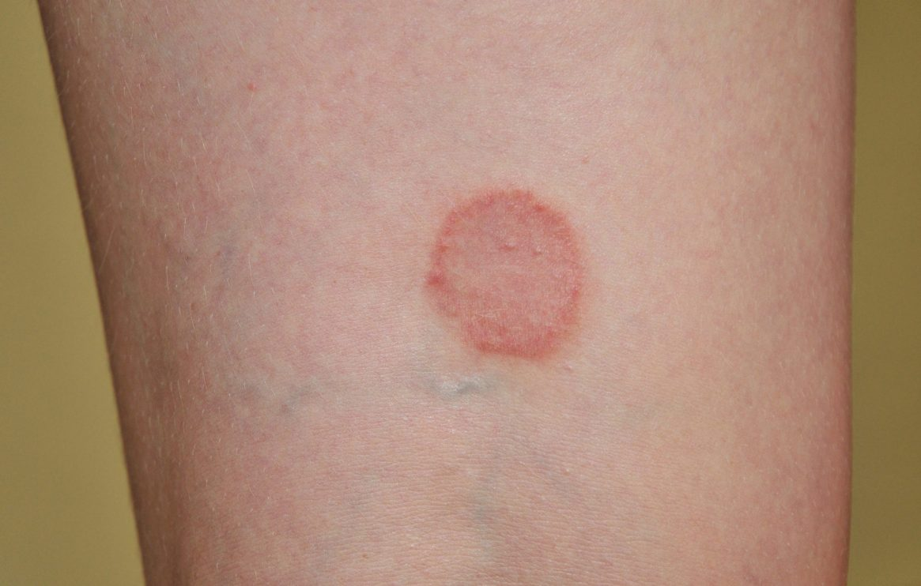
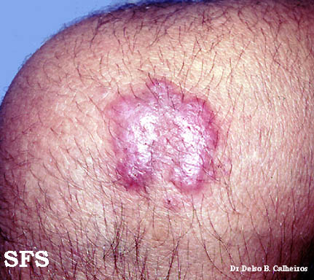
Types of fungal disease
Aspergillosis: Allergy reaction and Chronic lung condition occurs.
2. Ringworm: Red,circular rash is shown in skin and nails.
3.Blastomycosis: cough, fever, chills, muscle aches, joint pain, and chest pain.

Slide 8
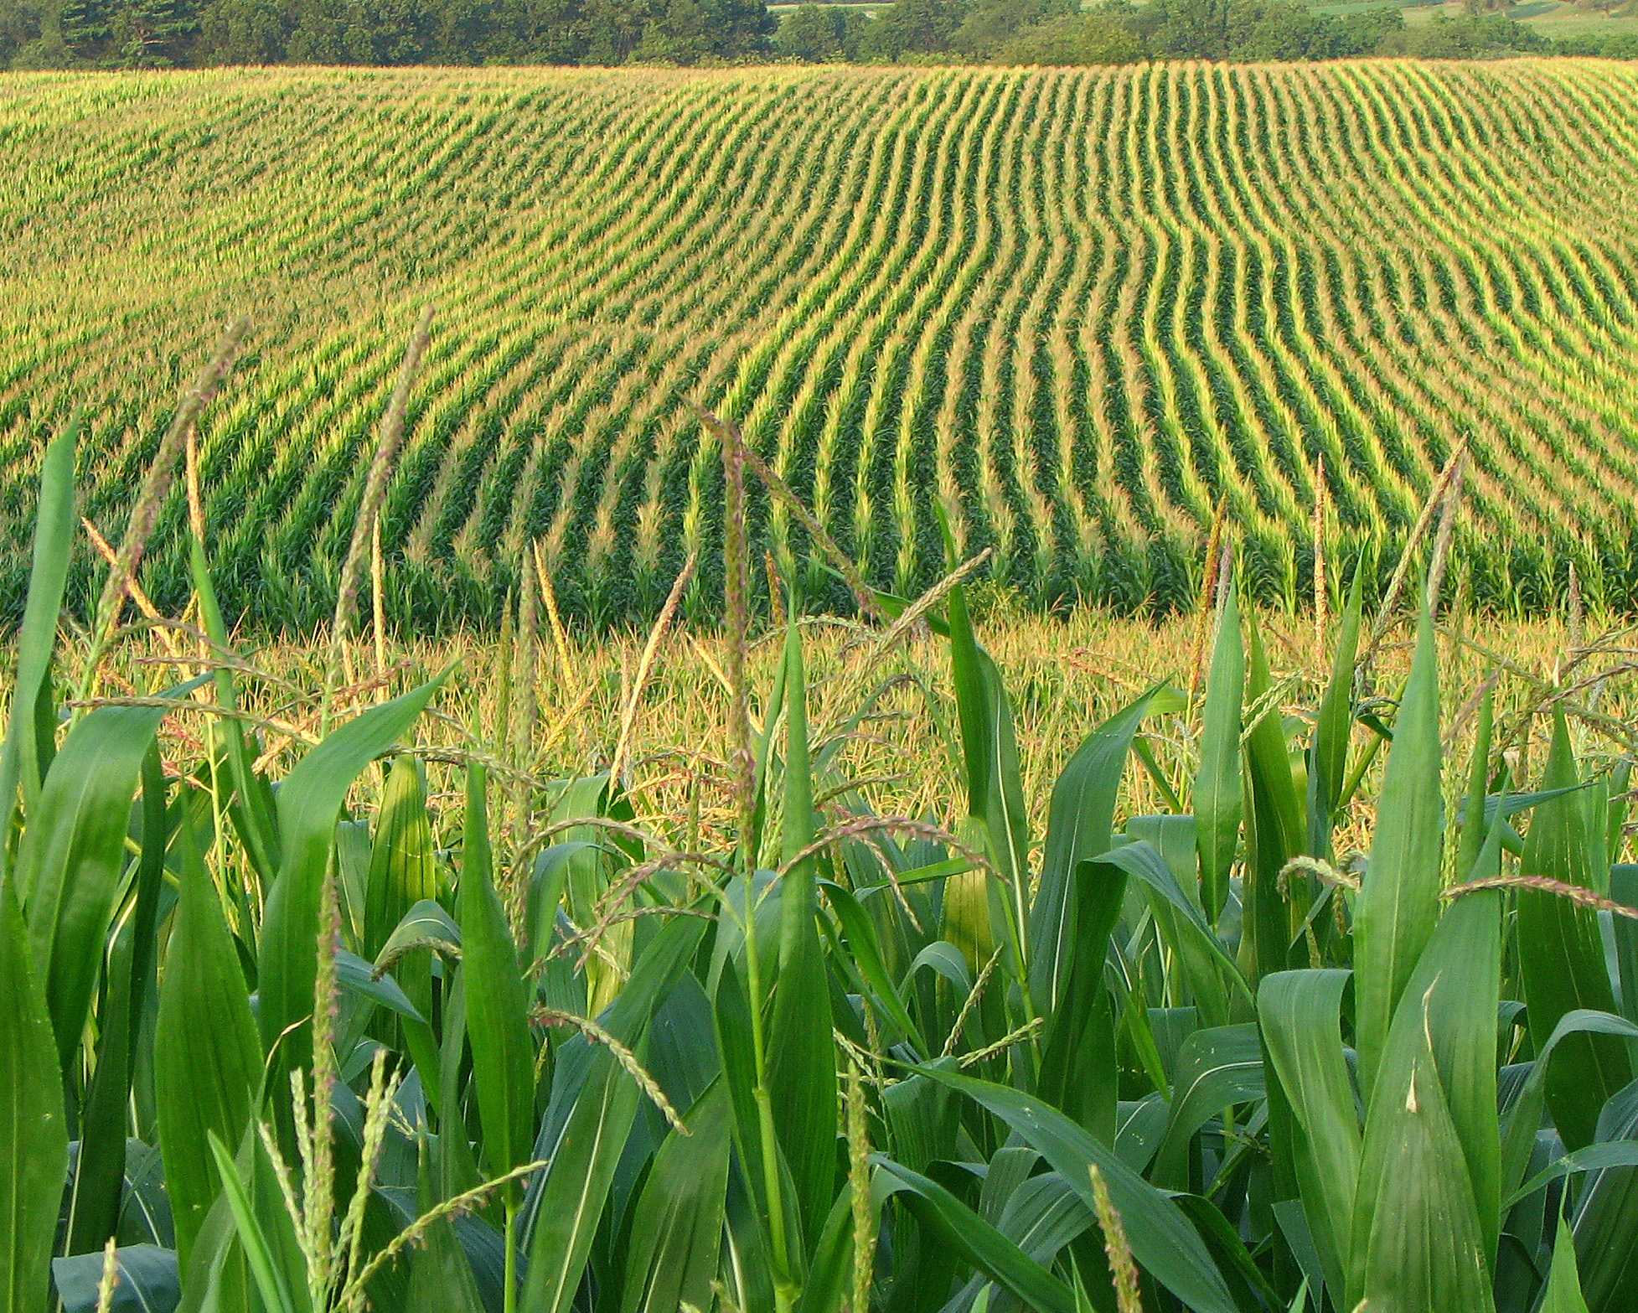


Economical Importance
Agriculture: Pest Agri engineering One gene one enzyme hypothesis Symbiosis
Medicine: i.Antibiotics ii.Post child birth bleed iii.Prevent cancer
Food: Mushroom Fermentation Baking

Slide 9


